Slide 1


Slide 2
Oracle Billing & Revenue Management
AGENDA
Item
Bill items
Fields of item storable Object
Item Object Status field Values
Formulae to calculate the due of an item

Slide 3
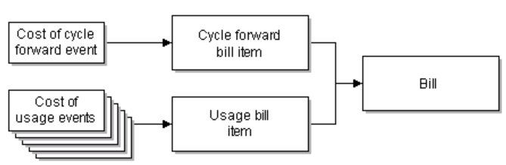
Items
Item objects in the BRM database store accounts receivable (A/R) data for an account.
The BRM system stores the cost of the event, along with the cost of similar events generated by the customer, in an item in the BRM database.
The cost of the events stored in the items affects the current balances of the customer’s account.
During billing, the BRM system collects the items for an account in a bill, which is also stored in the database.

Slide 4
Item Storable Class
Storable class: /item Table name: item_t
There are two types of items:
bill items: which contribute to the total amount stored in a bill.
A/R items: which reflect actions on the A/R of an account or account bill, such as payments or adjustments.
BRM manages A/R by transferring amounts between A/R items and bill items.
item
Bill item
A/R item

Slide 5
Bill items
Bill items include cycle forward items, cycle arrears items, usage items, and custom items.
BRM tracks accounts receivable in these types of bill items:
Cycle forward items track the accounts receivable for cycle forward fees.
Cycle arrear items track the accounts receivable for cycle arrears fees.
Cycle forward arrears items track the accounts receivable for cycle forward arrears fees.
Usage items track the accounts receivable for usage fees, purchase fees, and cancel fees. These fees are stored in the /item/misc storable object.
An /item/misc object is created for each account and for every service that the account owns. This allows you to manage fees for each service independently; for example, you can display the usage fees for separate telephony services.
Custom items track the accounts receivable for customized bill items you create.

Slide 6
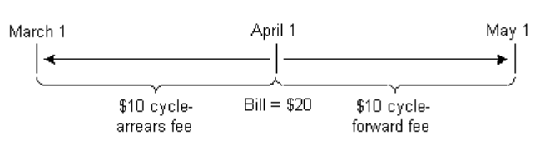
Cycle forward items:
Track the accounts receivable for cycle forward fees. Cycle forward events charge a fee for future service.
For example
when a customer pays the monthly cycle forward fee for a cell phone service, the customer pays for the coming month. With a yearly cycle forward fee, the customer pays for the entire year in advance.
There are five cycle forward event types to support: monthly, bimonthly, quarterly, semiannual, and annual fees.
Cycle arrear items
Track the accounts receivable for cycle arrears fees.
Cycle arrears events occur at the end of the month to charge the customer for the past month. When a customer pays a cycle arrears fee, the customer pays for the month that has already occurred.
In the following figure, the customer owns two plans, each with a cycle fee.
The bill created on April 1 includes:
A $10 cycle arrears fee for March
A $10 cycle forward fee for April

Slide 7
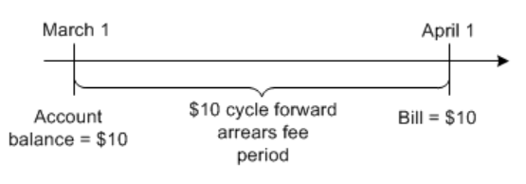
Cycle forward arrears events
Cycle forward arrears events occur at the beginning of the month to charge customers for the upcoming month, but the cycle fees are not billed until the end of the month when billing is run. When a customer pays a cycle forward arrears fee, the customer pays for the month that has just passed.
Cycle forward arrears fees are stored in cycle forward arrears items. The cycle forward arrears event is assigned to the item that belongs to the next accounting cycle. This way, the fee is tracked in the account balance for the current cycle, but it isn’t billed until the end of the cycle:

Slide 8
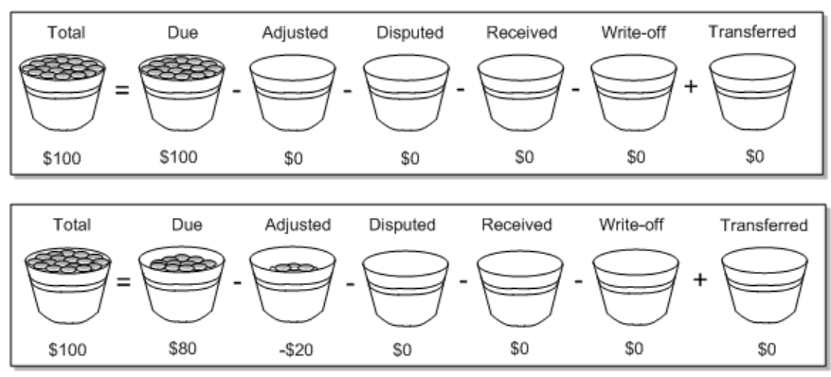
Fields of item storable class
All item objects in the BRM database include the same fields.
The following item fields are of particular importance in understanding the flow of amounts through the BRM accounts receivable system:
You can think of the Due, Adjusted, Disputed, Transferred, and Received fields as buckets that contain coins.
As the BRM system manipulates A/R, it moves coins among these buckets, but it never changes the number of coins in the Total bucket. The Total bucket contains the coins from all the events linked to the item.

Slide 9
Fields of item storable object
Total
The sum of all balance impacts to a currency resource that occurred as a result of the events that contribute to the item. For example, the usage item stores the costs of the usage events a customer generated during the accounting cycle.
Due
The amount owed by the customer for this item. Initially, Due is the same as Total, but after A/R is received from or transferred to another item the amounts may be different. For example, the Total and Due of a bill item are the same when the item is created, but payments, adjustments, or disputes reduce the Due.
Adjusted
The total amount of adjustments made to the item, the net of both debit and credit adjustments. Because most adjustments are credits, the amount in the adjustment field usually reduces the Due of the item.
Disputed
The total amount of unresolved disputes against the item. The disputed amount reduces the Due of the item.

Slide 10
Transferred
The total amount transferred out of this item and into another item.
Received
The total amount transferred into this item from another item, which is usually a payment item.
Write-off
A write-off is an accounts receivable transaction that removes an uncollectable balance from a customer’s account so it is not considered as an asset for accounting purposes.

Slide 11
Item Object Status field Values
Status
The status of the item, can be
1 - Pending (unbilled)
2 - Open (billed)
4 - Closed (zero amount due).
Items generally move from Pending to Open to Closed status, but closed items can be reopened.
When thinking about item fields, remember that:
Adjustment and dispute items are different from the Adjusted and Disputed fields in an item.
Adjustment and dispute items have Adjusted and Disputed fields, although these fields are unlikely to store a value other than zero for these items.
A transfer operation places values in the Transferred field of the source item and the Adjusted, Disputed, Received, or Write-off field of the target item, based on the AR operation being performed.
Credit values are stored as negative numbers.

Slide 12

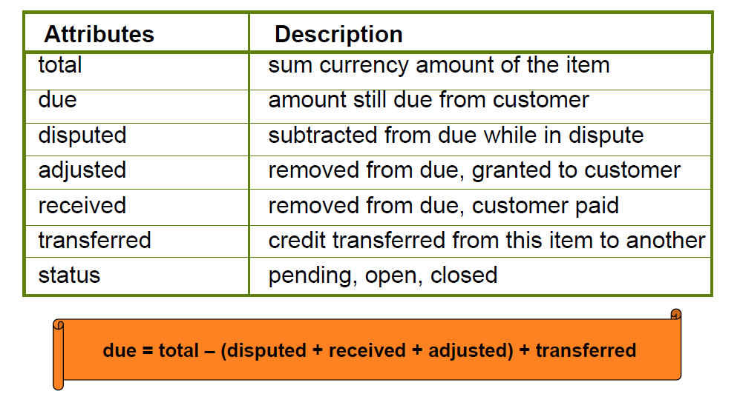
A/R Item Attributes
Formulae to calculate the due of an item

Slide 13
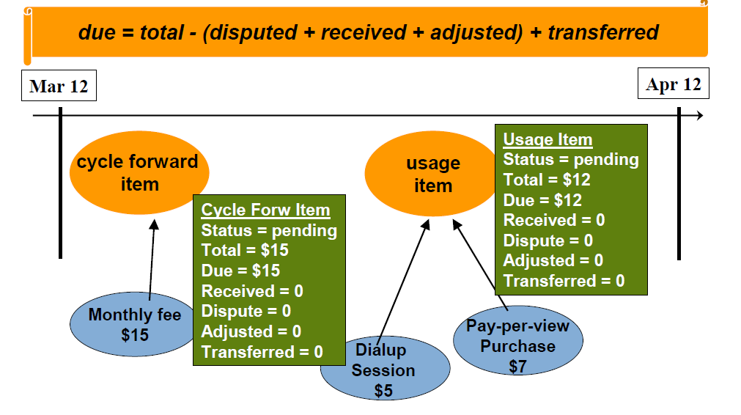
Bill Items

Slide 14
Hints and Important Points About Bill items
Check the status of bill items as soon as they are triggered & before billing.
Check the status of bill items after billing.
Check the due values & item_total of the billable items before & after billing.
Check bill items and the balance impact events which are responsible for the item total of bill items.
Check how the status of bill items getting changed from pending [unbilled], open[billed] and closed[Due zero].
Check /item storable class fields, ar_billinfo_obj, parent_ar_billinfo, effective_t.

Slide 15


